Slide 1
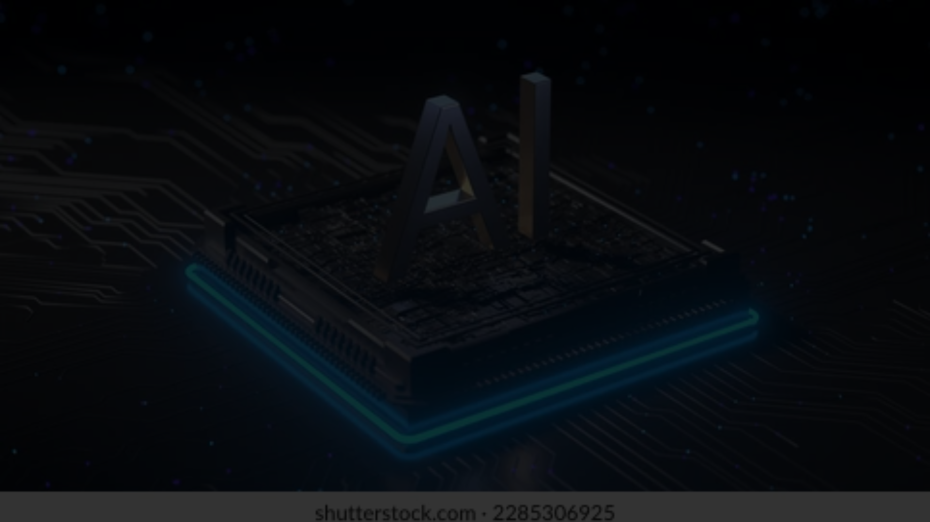
Unleashing the Power of Artificial Intelligence: A Revolution in Our Hands
In the ever-evolving landscape of technology, Artificial Intelligence (AI) tools have emerged as a transformative force, reshaping the way we live, work, and interact with the world around us.

Slide 2
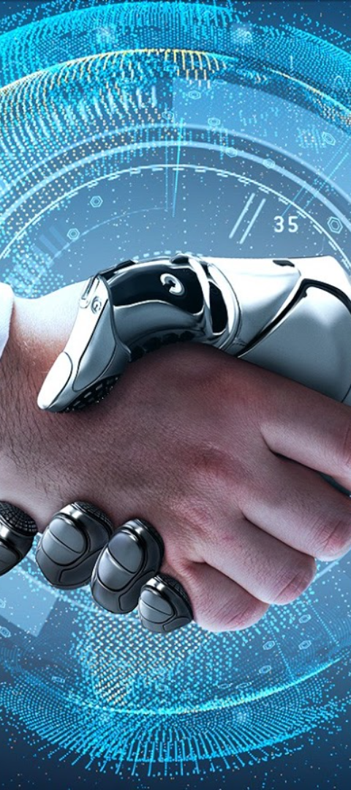
Efficiency and Automation
1
Enhanced Productivity
2
Time Saving
AI streamlines operations, optimizing resources and minimizing errors for a more reliable workflow.
Tasks that traditionally required human intervention are now automated, saving time and effort.
3
Consistent Workflow
Automation contributes to a more consistent and error-free operational process.

Slide 3
Data Analysis and Insights
1
Meaningful Insights
AI's ability to analyze vast amounts of data enables organizations to derive valuable insights and make data-driven decisions.
2
Competitive Edge
Identifying patterns that may have otherwise gone unnoticed empowers businesses to stay ahead in a competitive environment.
3
Speed and Accuracy
AI's incredible speed in data analysis enhances decision-making processes.

Slide 4
Personalization and User Experience
Enhanced Satisfaction
Tailored Interactions
Customer Loyalty
AI algorithms understand user preferences, delivering personalized experiences that foster customer loyalty.
Content recommendations and product suggestions are tailored to individual user preferences, enhancing satisfaction.
Personalized experiences lead to increased customer loyalty and engagement.

Slide 5
Healthcare Advancements
1
Diagnostic Assistance
2
Medical Imaging Analysis
3
Life-Saving Innovations
AI accelerates medical research and enhances the precision of treatments, ultimately improving patient outcomes.
Machine learning algorithms analyze medical images, aiding healthcare professionals in making accurate diagnoses.
AI-driven advancements in healthcare contribute to saving lives and improving patient care.

Slide 6
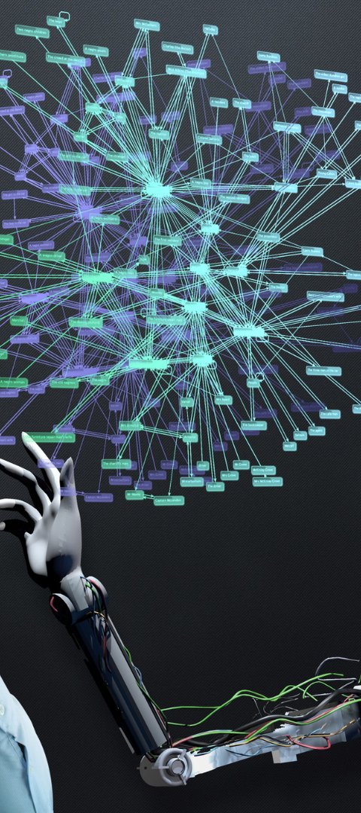



Enhancing Creativity
Augmenting Human Creativity
AI-powered tools assist artists, designers, and content creators by suggesting improvements and generating original content.
New Frontiers
The collaboration between human creativity and AI innovation opens new frontiers of creative possibilities.
Innovation and Collaboration
AI's role in augmenting human creativity leads to innovative collaborations and breakthroughs.

Slide 7
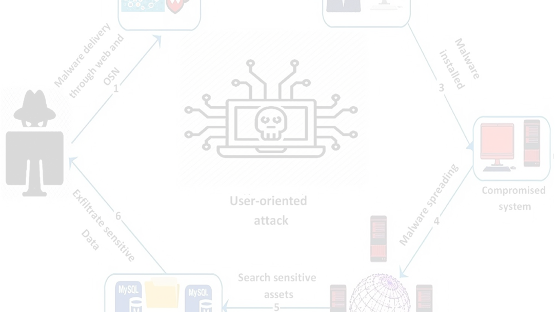
Cybersecurity and Risk Mitigation
Advanced Threat Detection
Real-Time Monitoring
Proactive Security
Identifying patterns indicative of potential cyber attacks in real time is crucial for mitigating risks.
AI's proactive approach is essential in mitigating risks posed by evolving cybersecurity threats.
AI tools provide advanced threat detection and prevention mechanisms, safeguarding sensitive data.

Slide 8
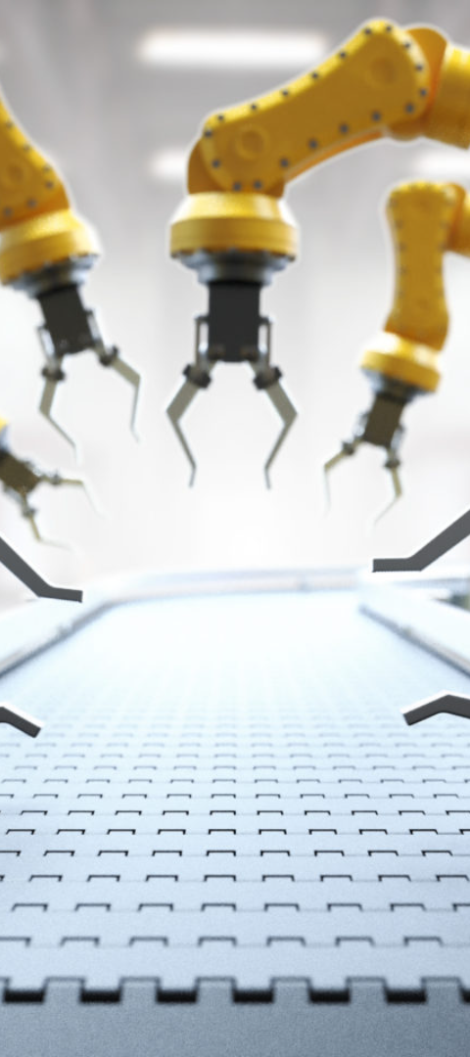
Revolutionizing Industries
1
Paradigm Shift
The integration of AI is a paradigm shift that permeates every aspect of our lives, revolutionizing industries and addressing complex challenges.
2
Key Driver of Innovation
AI's potential to revolutionize industries and enhance efficiency makes it a key driver of innovation and progress.
3
Shaping the Future
As we navigate the future, the integration of AI will undoubtedly shape a world where the impossible becomes achievable.

